Slide 1

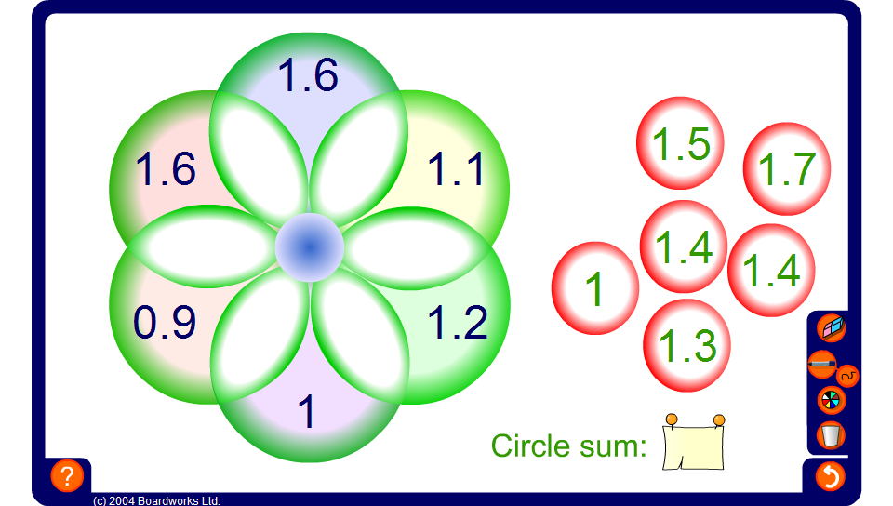


Circle sums – one decimal place
Notes:
The circle sum puzzle on this slide uses numbers written to one decimal place.

